Slide 1

Romans 1–5
Lionel Windsor | Moore College | February 2019

Slide 2
The Importance of Romans

Slide 3

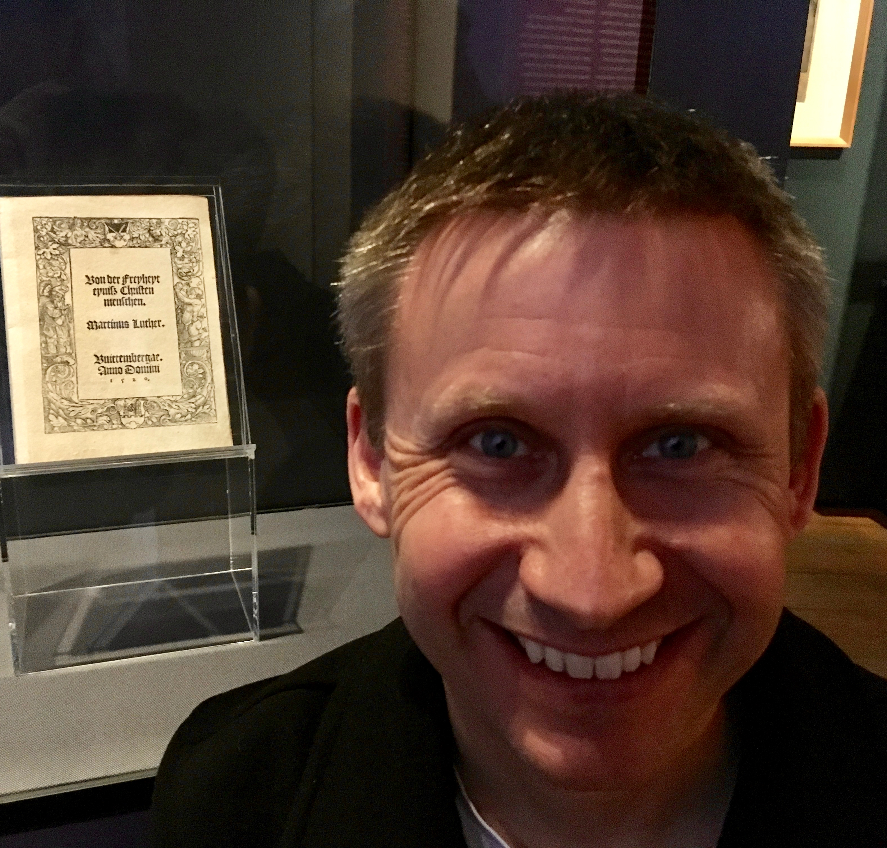

The Importance of Romans
Original edition of The Freedom of a Christian Person by Martin Luther, Lutherhaus, Lutherstadt Wittenberg

Slide 4
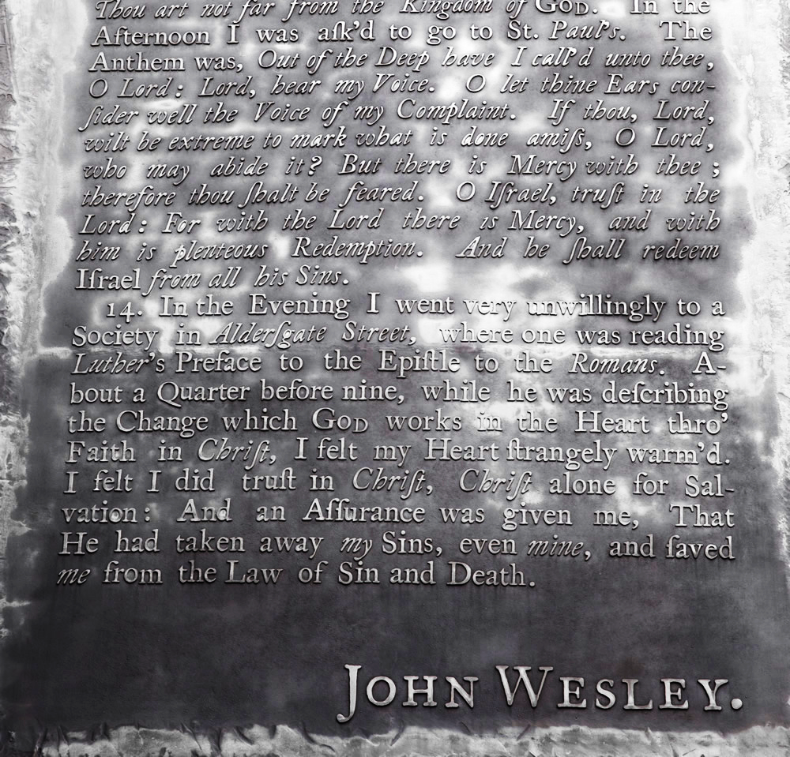
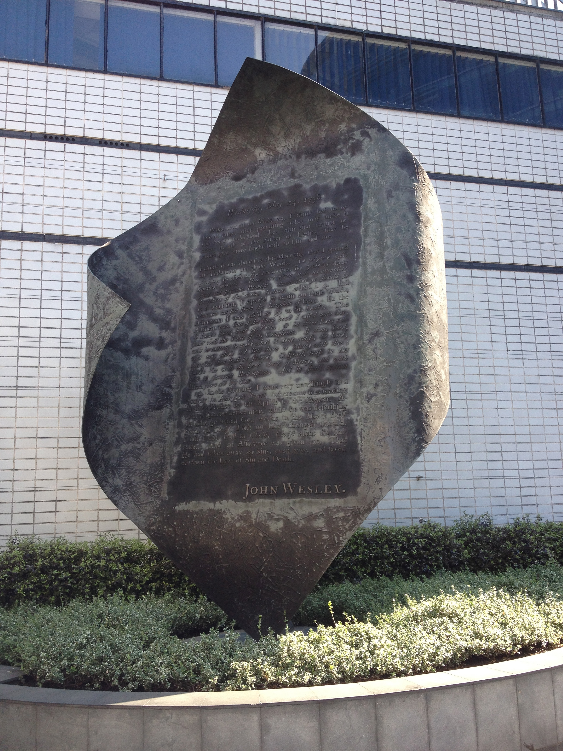
The Importance of Romans
Aldersgate Flame, Memorial to the conversion of John Wesley, Outside the Museum of London

Slide 5
Some background to Romans

Slide 6
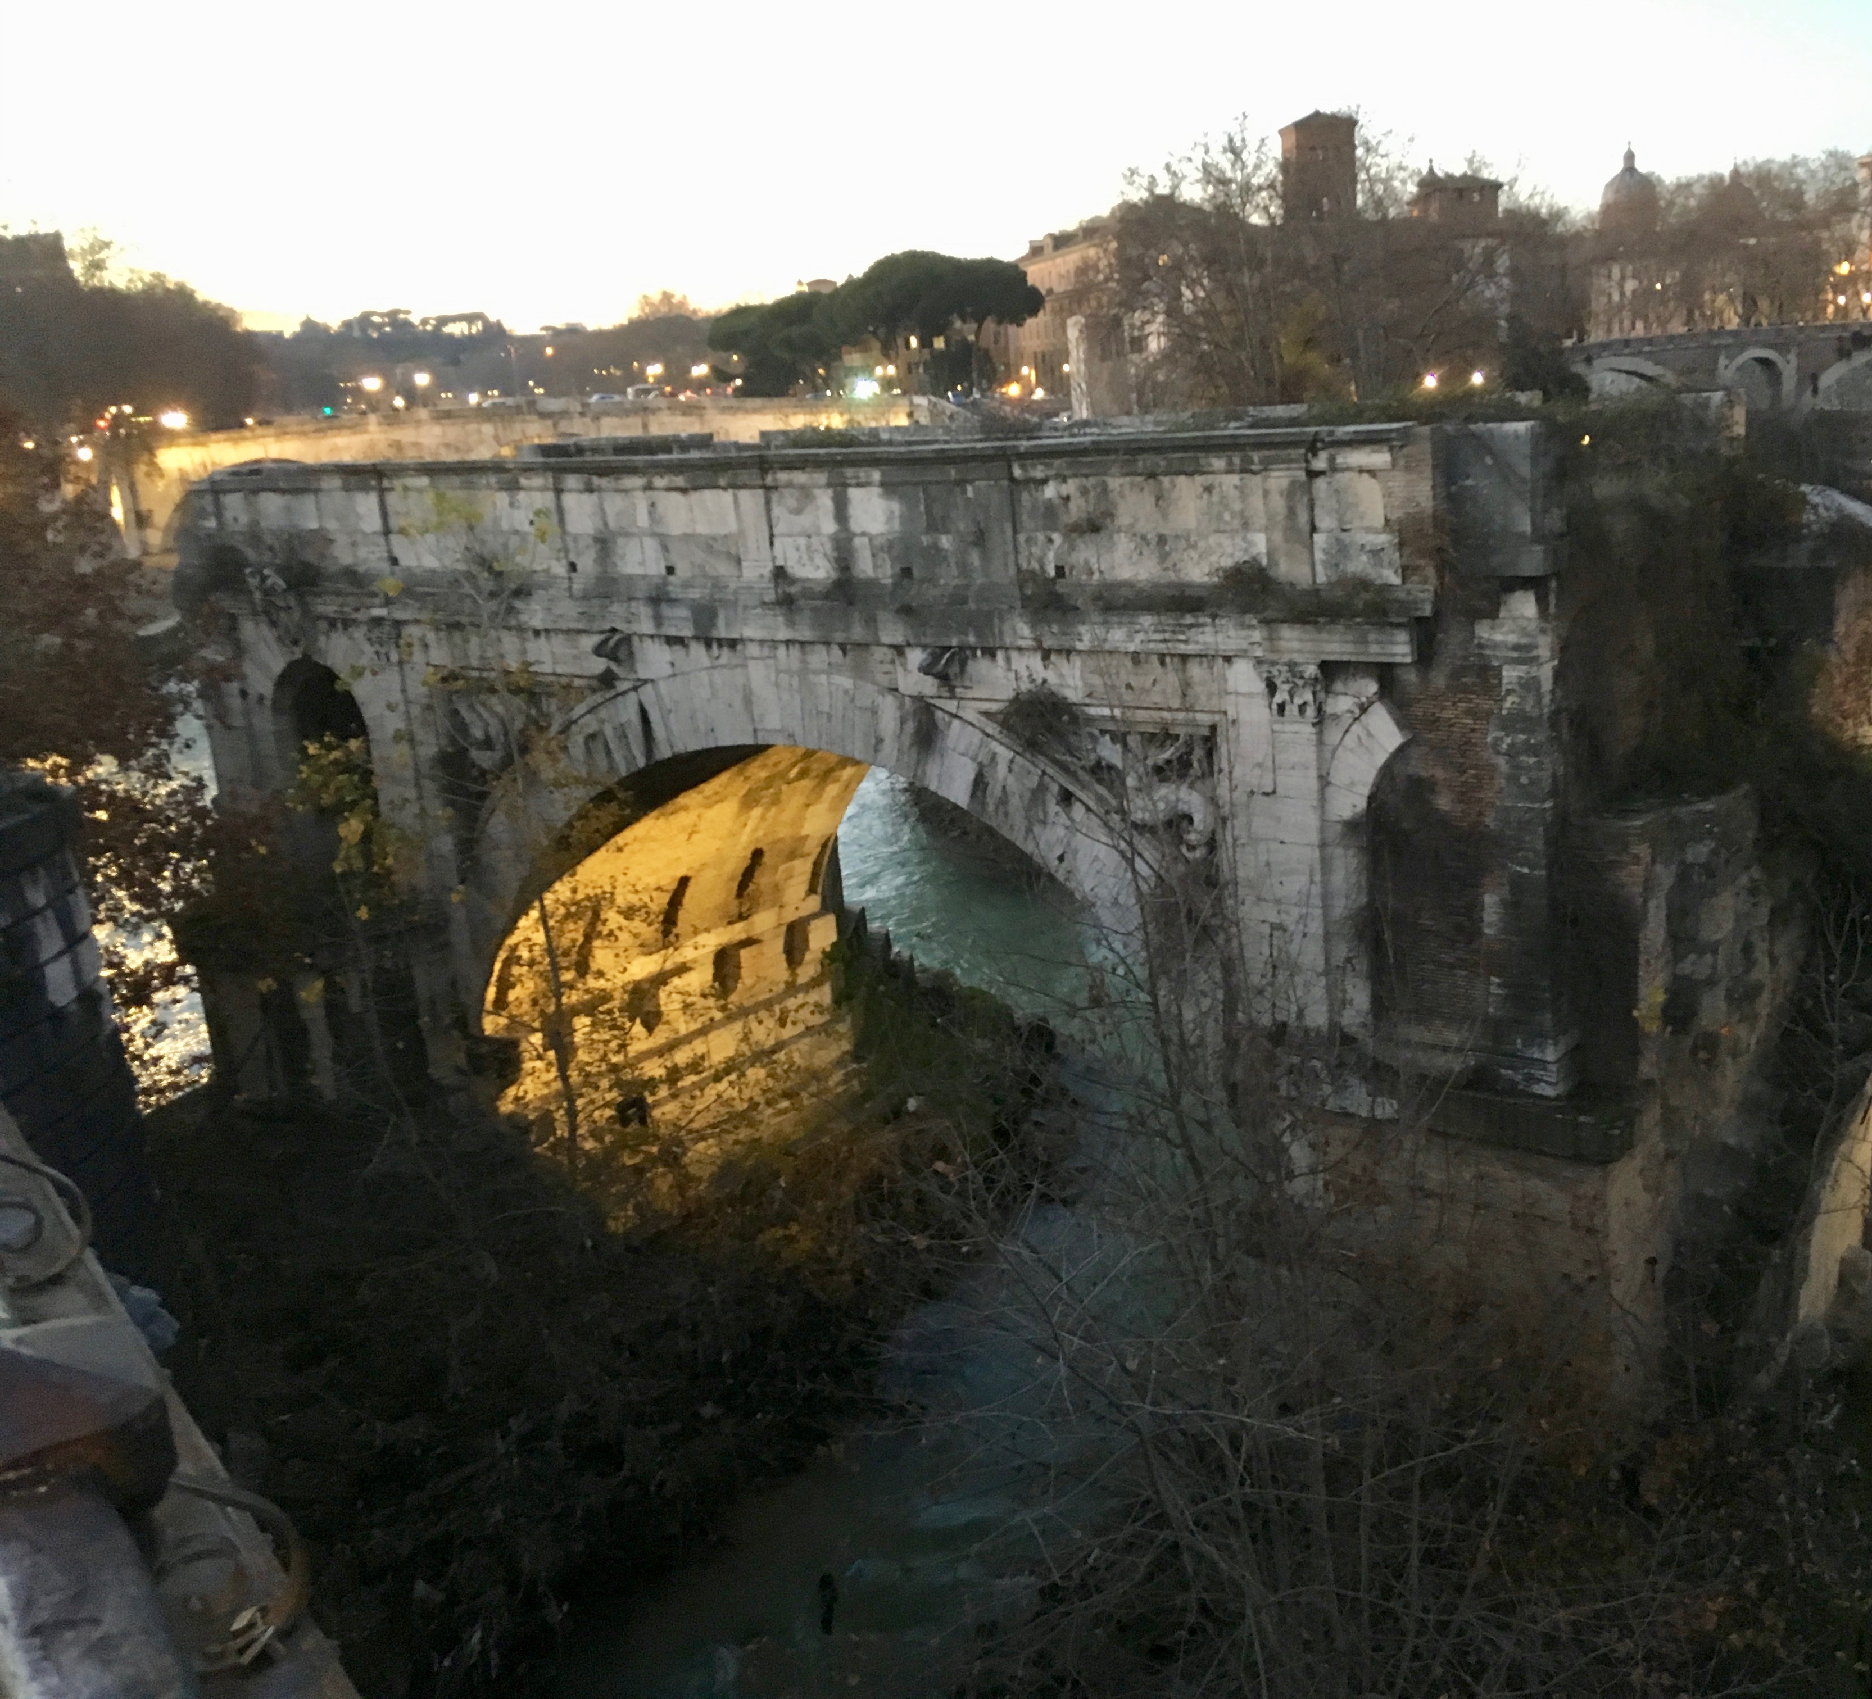
Some background to Romans
Section of the 2,200-year-old Pons Aemilius (also called Ponte Rotto, "Broken Bridge"), Rome

Slide 7
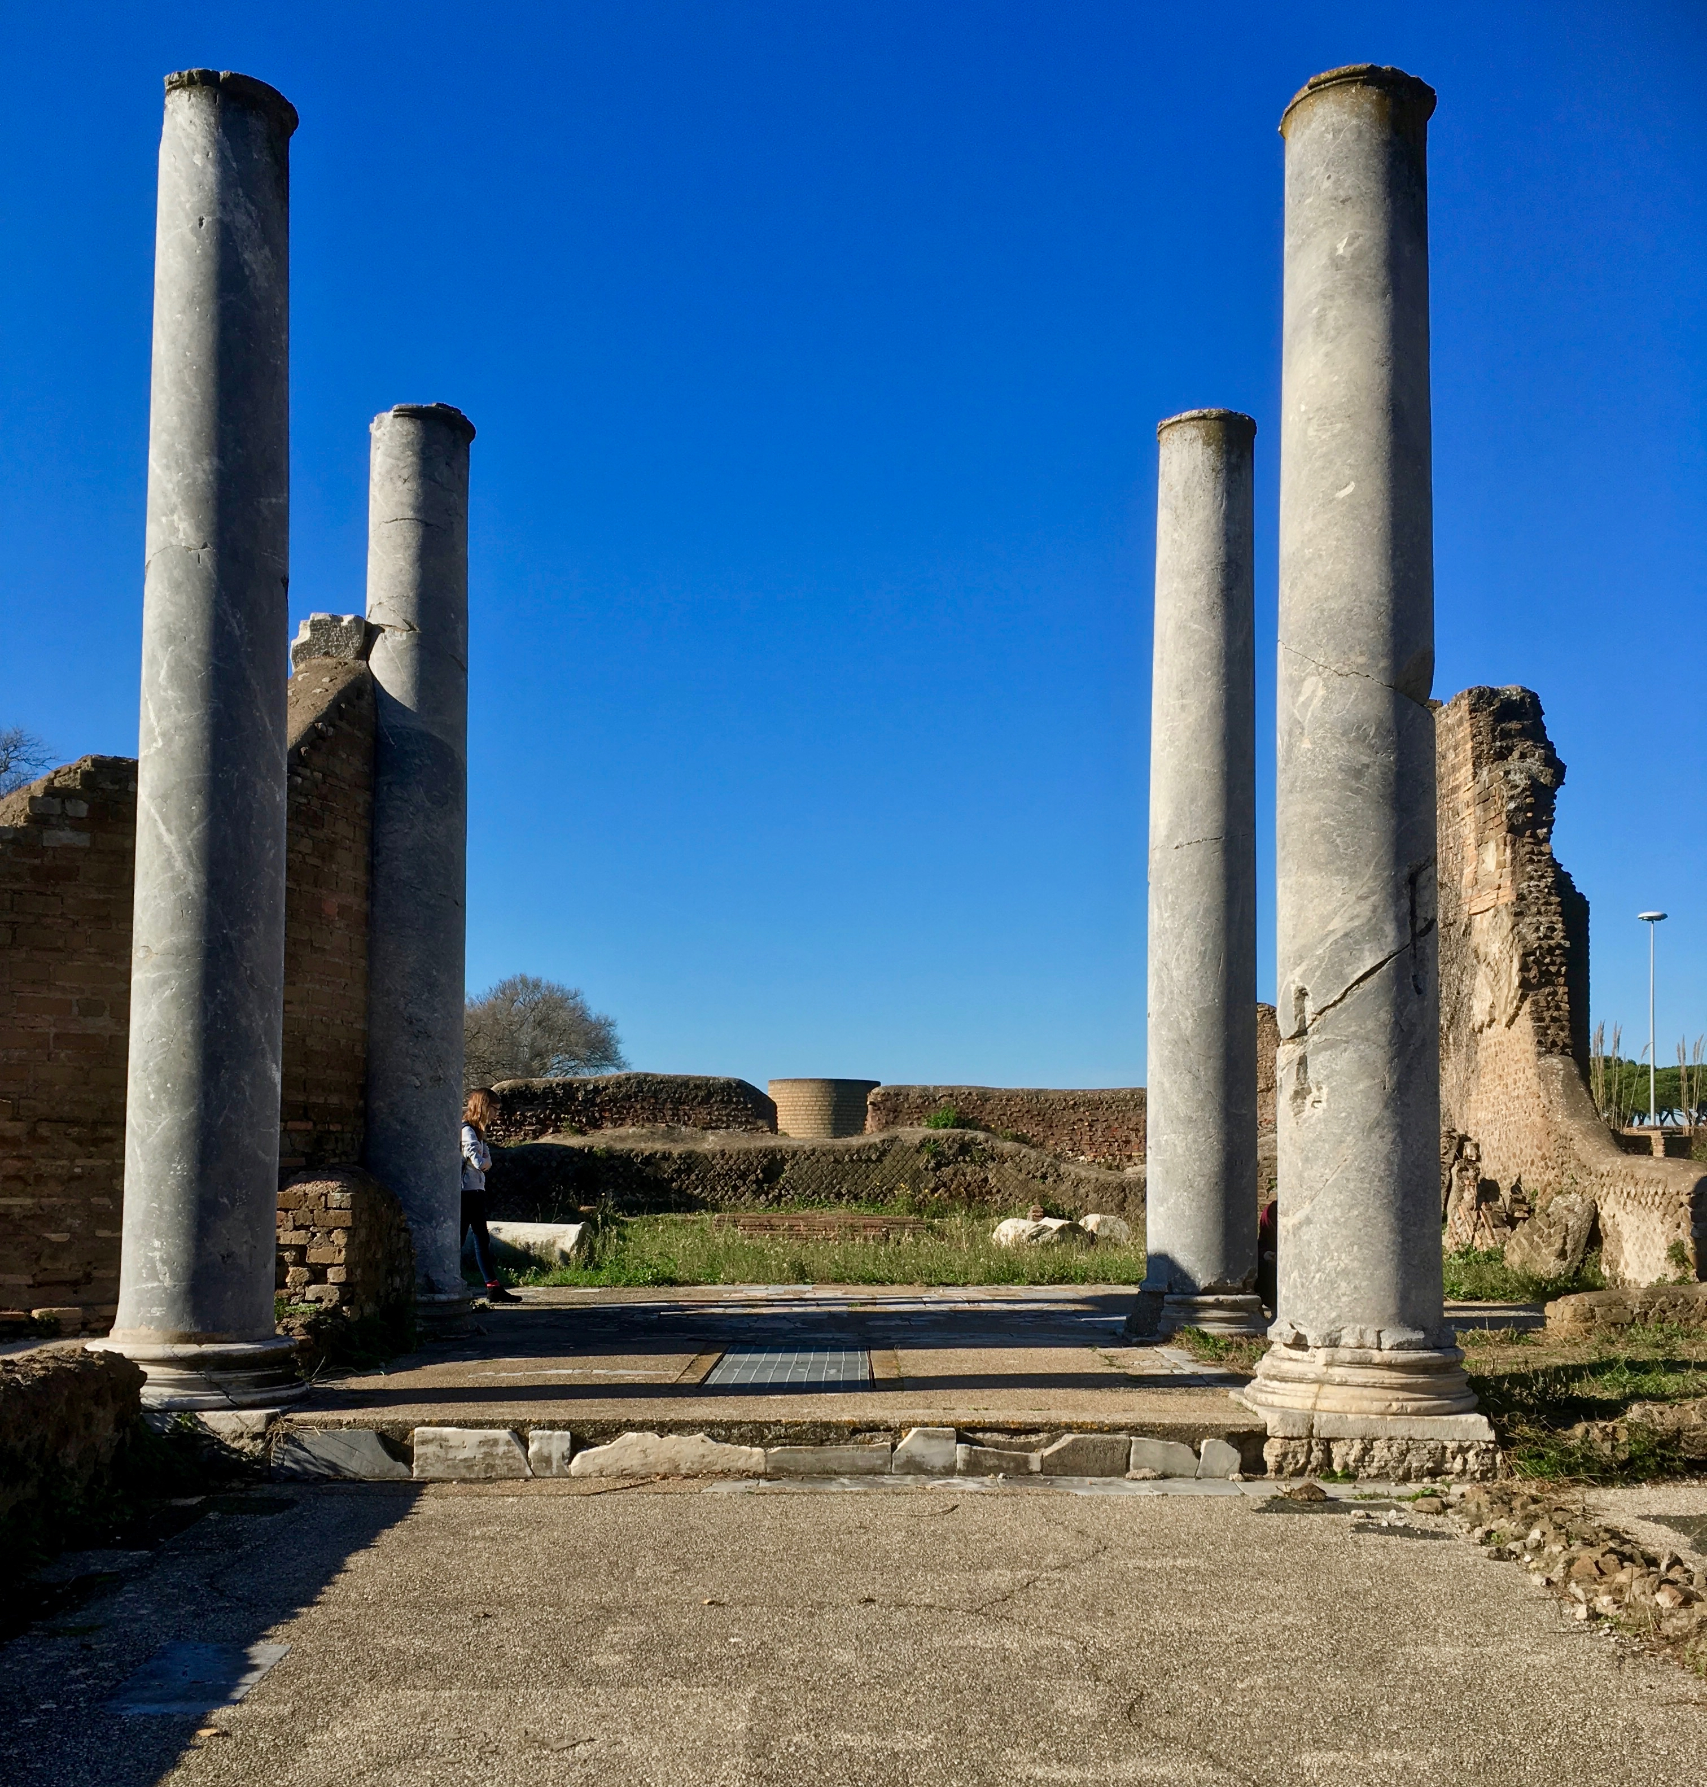
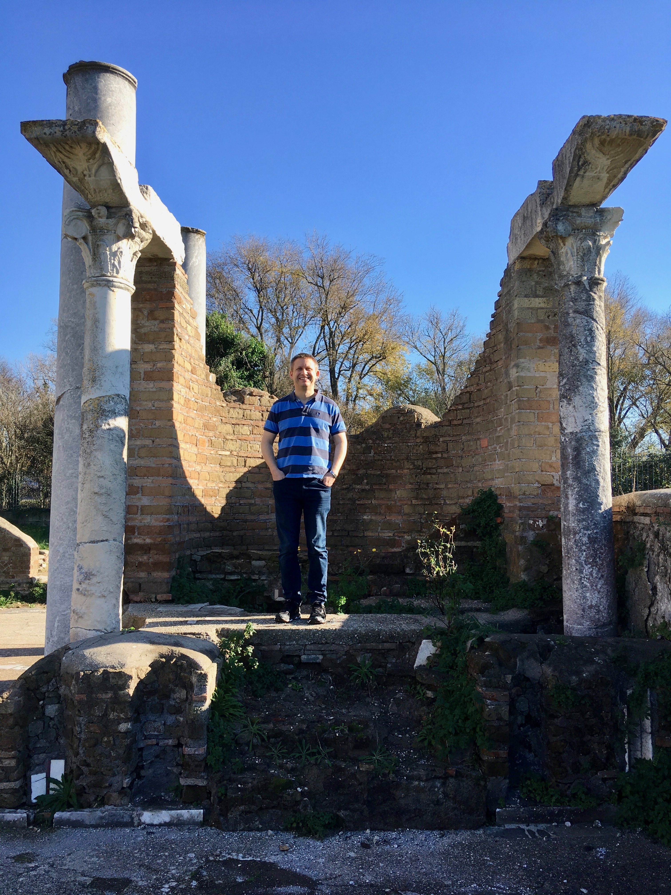
Some background to Romans
Ruined synagogue, on the outskirts of Ostia Antica, Italy.
Originally built 1st century AD (about the time Paul was writing Romans); expanded up to 4th century AD.
With the prominent Apsidal aedicula housing the Torah Scroll

Slide 8
The purpose of Romans
Theological
Pastoral
Missional

Slide 9
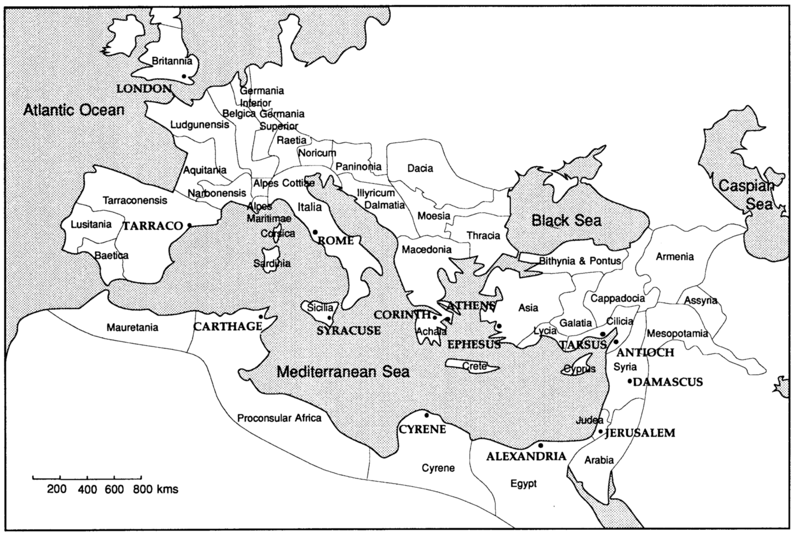
The purpose of Romans

Slide 10

A logical argument

Slide 11
Romans 1:1–7 | All about Jesus
Paul’s ministry to the nations is part of the fulfilment of God’s great plans for the world through his Son. These plans are rooted in the Scriptures and Israel, but now through the risen Lord Jesus Christ they concern all the nations of the world.
So does Paul not care about individuals, e.g. in Rome?
… the gospel of God, which he promised beforehand through his prophets in the holy Scriptures, concerning his Son, … Jesus Christ our Lord … (Rom 1:1–4)

Slide 12
Romans 1:8–17 | The gospel for everyone
Paul cares about those in Rome, because the gospel is for everyone.
So does Paul not care about individuals, e.g. in Rome?
Not everyone needs this righteousness and salvation, do they?
¹⁶ For I am not ashamed of the gospel, because it is the power of God that brings salvation to everyone who believes: first to the Jew, then to the Gentile. ¹⁷ For in the gospel the righteousness of God is revealed—a righteousness that is by faith from first to last, just as it is written: “The righteous will live by faith.”

Slide 13
Romans 1:18–32 | God’s wrath against humanity
Human beings have turned away from God, in a “downward spiral” of evil and foolishness. This is a manifestation of God’s wrath, and deserves God’s wrath in the future too.
Not everyone needs this righteousness and salvation, do they?
Those sinners really are stupid and evil, aren’t they?
¹⁸ The wrath of God is being revealed from heaven against all the godlessness and wickedness of people, who suppress the truth by their wickedness,

Slide 14
Romans 2:1–16 | Deeds not knowledge
If you judge others, you need to realise that you’re subject to the same critique.
What matters when it comes to God’s judgment is not how much we know, or who we are, but what we have done.
Those sinners really are stupid and evil, aren’t they?
So the job of God’s people is to teach others to do good works.
⁶ God “will repay each person according to what they have done.”

Slide 15
Romans 2:17–29 | The failed Jewish teacher
If you think you can solve the problem of human sin by teaching people to keep God’s law, you’ve forgotten that you’re a sinner too. Nobody will listen to you, and you’ll be a failure.
So the job of God’s people is to teach others to do good works.
So Jews can’t benefit God’s glory in any way.
²³ You who boast in the law, do you dishonor God by breaking the law? ²⁴ As it is written: “God’s name is blasphemed among the Gentiles because of you.”

Slide 16
Romans 3:1–8 | Our sin, God’s glory
Human sin, when combined with God’s word in the law, glorifies God in an unexpected way. It shows that his judgment is just!
(And anyone who tries to argue that this is absurd deserves to be condemned themselves)
So Jews can’t benefit God’s glory in any way.
Paul, you’re sounding very judgmental. Are you an exception?
⁵ …our unrighteousness brings out God’s righteousness more clearly…

Slide 17
Romans 3:9–20 | No-one is righteous
There is nobody in the world who is righteous. This is what God’s law teaches Jews, and so the whole world is held to account.
Paul, you’re sounding very judgmental. Are you an exception?
So we’re all condemned, and the law just makes it worse.
²⁰ Therefore no one will be declared righteous in God’s sight by the works of the law; rather, through the law we become conscious of our sin.

Slide 18
Romans 3:21–31 | Justification through Christ
God’s righteousness comes to us through Jesus’ death on the cross. Jesus died as a sacrifice of atonement, so we are justified through faith in him, not by works of the law.
So we’re all condemned, and the law just makes it worse.
“Do we, then, nullify the law by this faith?” (v. 31)
²³ … for all have sinned and fall short of the glory of God, ²⁴ and all are justified freely by his grace through the redemption that came by Christ Jesus.

Slide 19
Romans 4:1–25 | Justified by faith not works
We are justified by faith in Christ and not by works. This is by God’s grace and not our merit. Abraham, the great forefather of Israel, is the prime example and model of faith.
“Do we, then, nullify the law by this faith?” (v. 31)
This faith can’t make any real impact on our lives
⁵ However, to the one who does not work but trusts God who justifies the ungodly, their faith is credited as righteousness.

Slide 20
Romans 5:1–11 | Peace and hope
Justification by faith makes a huge difference to our lives. It gives us peace with God and hope for the future, which enables us to persevere in suffering. It makes us confident to live knowing the God has already loved us deeply and will save us.
But there are so many threats to assurance: sin, death, law.
This faith can’t make any real impact on our lives
¹ Therefore, since we have been justified through faith, we have peace with God through our Lord Jesus Christ, ² … And we boast in the hope of the glory of God.

Slide 21
Romans 5:12–21 | Threats neutralised
Adam brings sin and death. But Christ brings justification and life, which is far more powerful. And the law seems like a threat because it increases sin—but actually it increases grace.
But there are so many threats to assurance: sin, death, law.
So should we sin more to increase grace? (6:1)
¹⁷ For if, by the trespass of the one man, death reigned through that one man, how much more will those who receive God’s abundant provision of grace and of the gift of righteousness reign in life through the one man, Jesus Christ!

Slide 22
Resources
Douglas Moo. The Epistle to the Romans. NICNT. Eerdmans, 1996.
Thomas Schreiner. Romans. BECNT. 2nd ed. Baker Academic, 2018.
For those who know Greek and want something more technical:
C. E. B. Cranfield, The Epistle to the Romans. 2 vols. T. & T. Clark. 1975–79.
More on Romans 1:26–27 in light of recent marriage redefinition:
https://www.abc.net.au/religion/the-bible-and-same-sex-marriage-a-response-to-robyn-whitaker-and/10095464
See www.liberty.sydney for resources for those wrestling with same-sex attraction

