Slide 2
Learning Christ
But that is not the way you learned Christ!—assuming that you have heard about him and were taught in him, as the truth is in Jesus, to put off your old self, which belongs to your former manner of life and is corrupt through deceitful desires, and to be renewed in the spirit of your minds, and to put on the new self, created after the likeness of God in true righteousness and holiness. (Ephesians 4:20-24)

Slide 3
Learning to Speak Christian
Therefore, having put away falsehood, let each one of you speak the truth with his neighbour, . . . Let no corrupting talk come out of your mouths, but only such as is good for building up, as fits the occasion, that it may give grace to those who hear. (Ephesians 4:25, 29)

Slide 4

Learning to Speak Christian in an Online World

Slide 5
In An Online World…
The Paradoxes of Social Media

Slide 6

Mediated Socialising
http://www.cnbc.com/2015/07/09/facebook-just-changed-the-friends-icon.html

Slide 7


Broadcast Conversations

Slide 8

Hyperconnected but misconnected
Cheng Dapang, Smash Palace: White Rabbit Gallery

Slide 9

Together Alone
flickr: chingster23

Slide 10
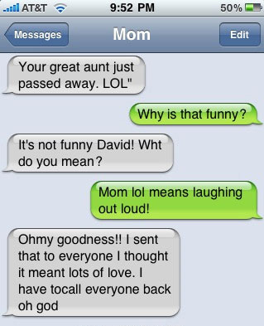
Words Multiplied, Communication Divided
Buzzfeed

Slide 11

Manufactured Authenticity

Slide 12
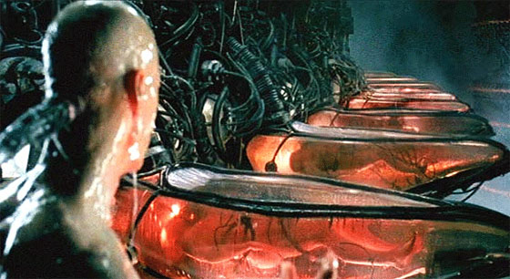
Controlled Freedom
Movie: The Matrix

Slide 13
Attitudes to Social Media

Slide 14
Attitudes to Social Media
Embracers

Slide 15
Attitudes to Social Media
Embracers
Naysayers

Slide 16
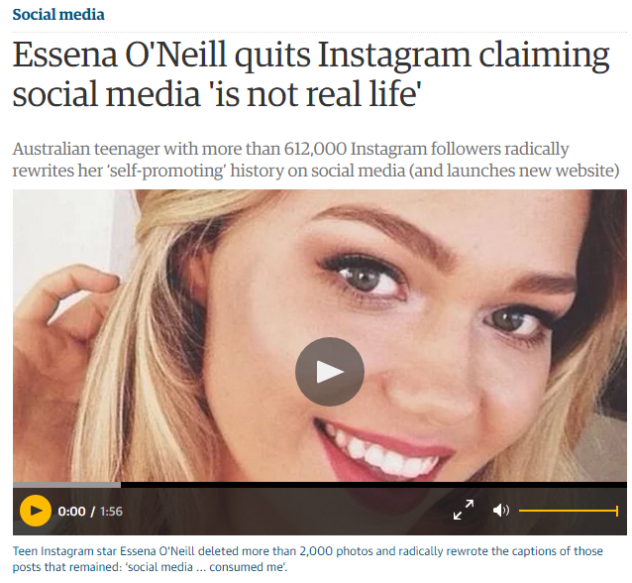
Attitudes to Social Media
Embracers
Naysayers
Conscientious Objectors

Slide 17
Attitudes to Social Media
Embracers
Naysayers
Conscientious Objectors
Disciplined Users

Slide 18
To Speak Christian
Learning
In an online world

Slide 19
The Word of Truth
In him you also, when you heard the word of truth, the gospel of your salvation, and believed in him, were sealed with the promised Holy Spirit, (Eph 1:13)

Slide 20
Broadcasting the Truth

Slide 21
Broadcasting the Truth
God’s social media:
Of this gospel I was made a minister [or “go-between”] according to the gift of God’s grace, which was given me by the working of his power. To me, though I am the very least of all the saints, this grace was given, to preach to the Gentiles the unsearchable riches of Christ, (Eph 3:7-8)

Slide 22
Broadcasting the Truth
God’s social media:
And he gave the apostles, the prophets, the evangelists, the shepherds and teachers, to equip the saints for the work of ministry, for building up the body of Christ, (Eph 4:11-12)

Slide 23
Broadcasting the Truth
God’s social media:
Stand therefore, having fastened on the belt of truth, and having put on the breastplate of righteousness, and, as shoes for your feet, having put on the readiness given by the gospel of peace. (Eph 6:14-15)

Slide 24
Broadcasting the Truth
God’s social media:
[pray] also for me, that words may be given to me in opening my mouth boldly to proclaim the mystery of the gospel, for which I am an ambassador in chains, that I may declare it boldly, as I ought to speak. (Eph 6:19-20)

Slide 25
Broadcasting the Truth
God’s Social Media
Opportunities in the Online World

Slide 26
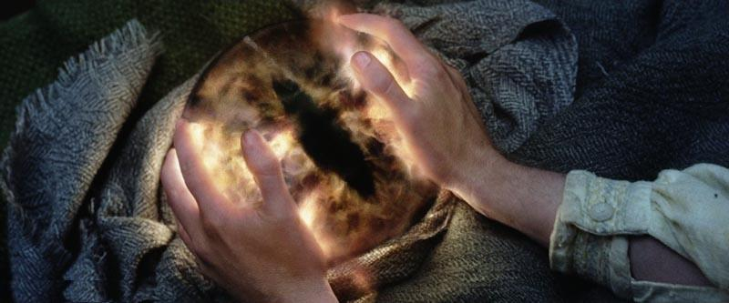
Broadcasting the Truth
God’s Social Media
Opportunities in the Online World
Challenges in the Online World
Lord of the Rings: The Two Towers

Slide 27
Broadcasting the Truth
God’s Social Media
Opportunities in the Online World
Challenges in the Online World
Learning to speak

Slide 28
Speaking the Truth in Love
Rather, speaking the truth in love, we are to grow up in every way into him who is the head, into Christ, from whom the whole body, joined and held together by every joint with which it is equipped, when each part is working properly, makes the body grow so that it builds itself up in love. (Eph 4:15-16)

Slide 29
Speaking the Truth in Love
. . . that you, being rooted and grounded in love, may have strength to comprehend with all the saints what is the breadth and length and height and depth, and to know the love of Christ that surpasses knowledge, that you may be filled with all the fullness of God. (Eph 3:18-20)

Slide 30
Speaking the Truth in Love:
Opportunities in the Online World
Speak the truth:
Therefore, having put away falsehood, let each one of you speak the truth with his neighbour, for we are members one of another. (Eph 4:25)

Slide 31
Speaking the Truth in Love:
Opportunities in the Online World
Speak the truth:
Walk in the light:
for at one time you were darkness, but now you are light in the Lord. Walk as children of light (for the fruit of light is found in all that is good and right and true), and try to discern what is pleasing to the Lord. Take no part in the unfruitful works of darkness, but instead expose them. For it is shameful even to speak of the things that they do in secret. (Eph 5:8-12)

Slide 32
Speaking the Truth in Love:
Challenges in the Online World

Slide 33
Speaking the Truth in Love:
Challenges in the Online World
Be angry and do not sin; do not let the sun go down on your anger, and give no opportunity to the devil. (Eph 4:26-27)

Slide 34
Speaking the Truth in Love:
Challenges in the Online World
Let no corrupting talk come out of your mouths, but only such as is good for building up, as fits the occasion, that it may give grace to those who hear. (Eph 4:29)

Slide 35
Speaking the Truth in Love:
Challenges in the Online World
And do not grieve the Holy Spirit of God, by whom you were sealed for the day of redemption. (Eph 4:30)

Slide 36
Speaking the Truth in Love:
Challenges in the Online World
Let all bitterness and wrath and anger and clamor and slander be put away from you, along with all malice. Be kind to one another, tenderhearted, forgiving one another, as God in Christ forgave you. (Eph 4:31-32)

Slide 37
Speaking the Truth in Love:
Challenges in the Online World
But sexual immorality and all impurity or covetousness must not even be named among you, as is proper among saints. (Eph 5:3)

Slide 38
Speaking the Truth in Love:
Challenges in the Online World
Let there be no filthiness nor foolish talk nor crude joking, which are out of place, but instead let there be thanksgiving. (Eph 5:4)

Slide 39
Speaking the Truth in Love:
Challenges in the Online World
For you may be sure of this, that everyone who is sexually immoral or impure, or who is covetous (that is, an idolater), has no inheritance in the kingdom of Christ and God. Let no one deceive you with empty words, for because of these things the wrath of God comes upon the sons of disobedience. Therefore do not become partners with them; (Eph 5:5-7)

Slide 40
Speaking the Truth in Love:
Challenges in the Online World
And do not get drunk with wine, for that is debauchery, but be filled with the Spirit, addressing one another in psalms and hymns and spiritual songs, singing and making melody to the Lord with your heart, giving thanks always and for everything to God the Father in the name of our Lord Jesus Christ, (Eph 5:18-20)

Slide 41
Speaking the Truth in Love:
Learning to Speak

